Slide 1
Yelp Summarization Miner Aspect-Based Sentiment Analysis Yelp Reviews
Jeff Fossett

Slide 2
Yelp Summarization Miner Aspect-Based Sentiment Analysis Yelp Reviews
YUMM
Jeff Fossett

Slide 3


Slide 4
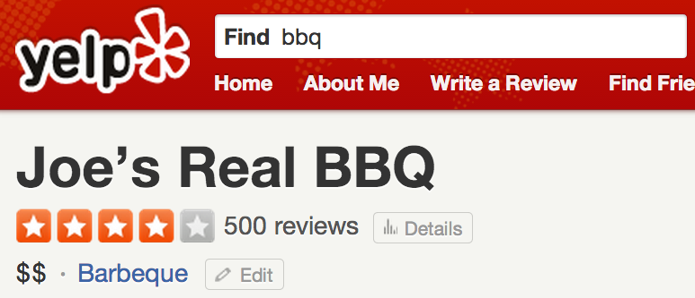

Slide 5
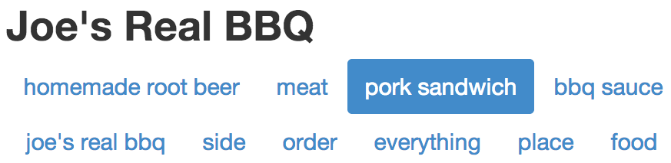

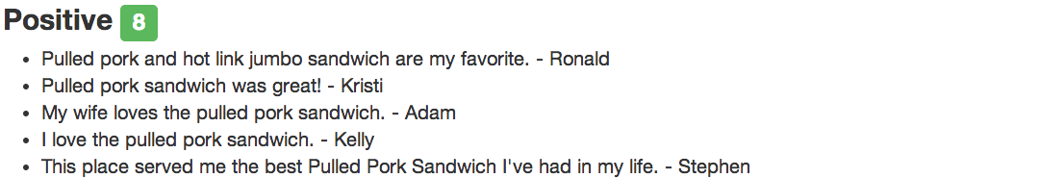
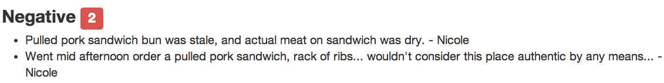

Slide 6
How it works
Input
Raw text and metadata of Yelp Reviews
Preprocessing
Sentence tokenization
Aspect Extraction
Part-of-Speech tagging
Shallow chunking
Fully dynamic
Opinion / Sentiment Classification
Supervised machine learning
Lightweight lexicon- & syntax-based classifiers
Two-stage approach
Summarization / Aggregation
Web application

Slide 7
Thanks!
demo: www.jeffreyfossett.com
github: Fossj117/opinion-mining

